Slide 1

$Q Tips
How to clean up your promise-based code with:
$q and route resolve
Notes:
My topic today - $q tips, cleaning up your promise-based code
Won’t cover everything to do with promises (you could spend hours on that) but hopefully by presenting a common app scenario, this will give you some new ideas on how to make your code better
And yes, that is a picture of Q holding a puppy

Slide 2

Notes:
This is Fred he just discovered angular (Go Fred)
Waiting for an opportunity to use it.

Slide 3

Notes:
Here’s fred’s boss – he wants fred to write a weather dashboard that displays
The weather of all the cities we have offices in
(because The world needs another weather dashboard)!

Slide 4

Notes:
Fred talks his boss into letting his use angular! Good move Fred –

Slide 5
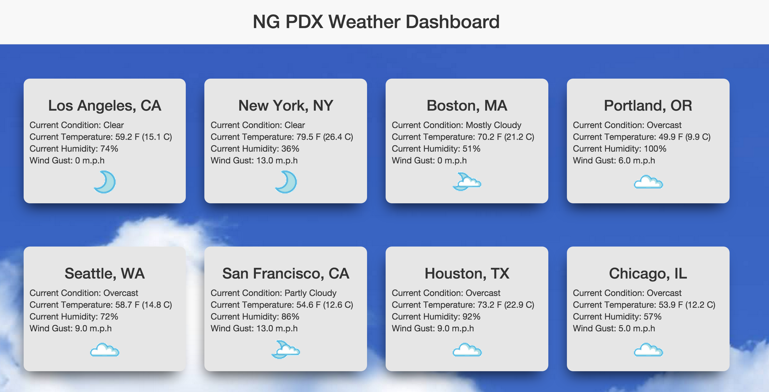
Weather Dashboard
Notes:
This is Fred’s weather dashboard.
Has a controller and a route – when his controller loads he makes some http calls to get his data and when it comes back, he pushes the data out onto the DOM and boom weather dashboard
Fred’s dashboard looks pretty slick, however, let’s look under the hood at his controller and html and see how everything looks.

Slide 6
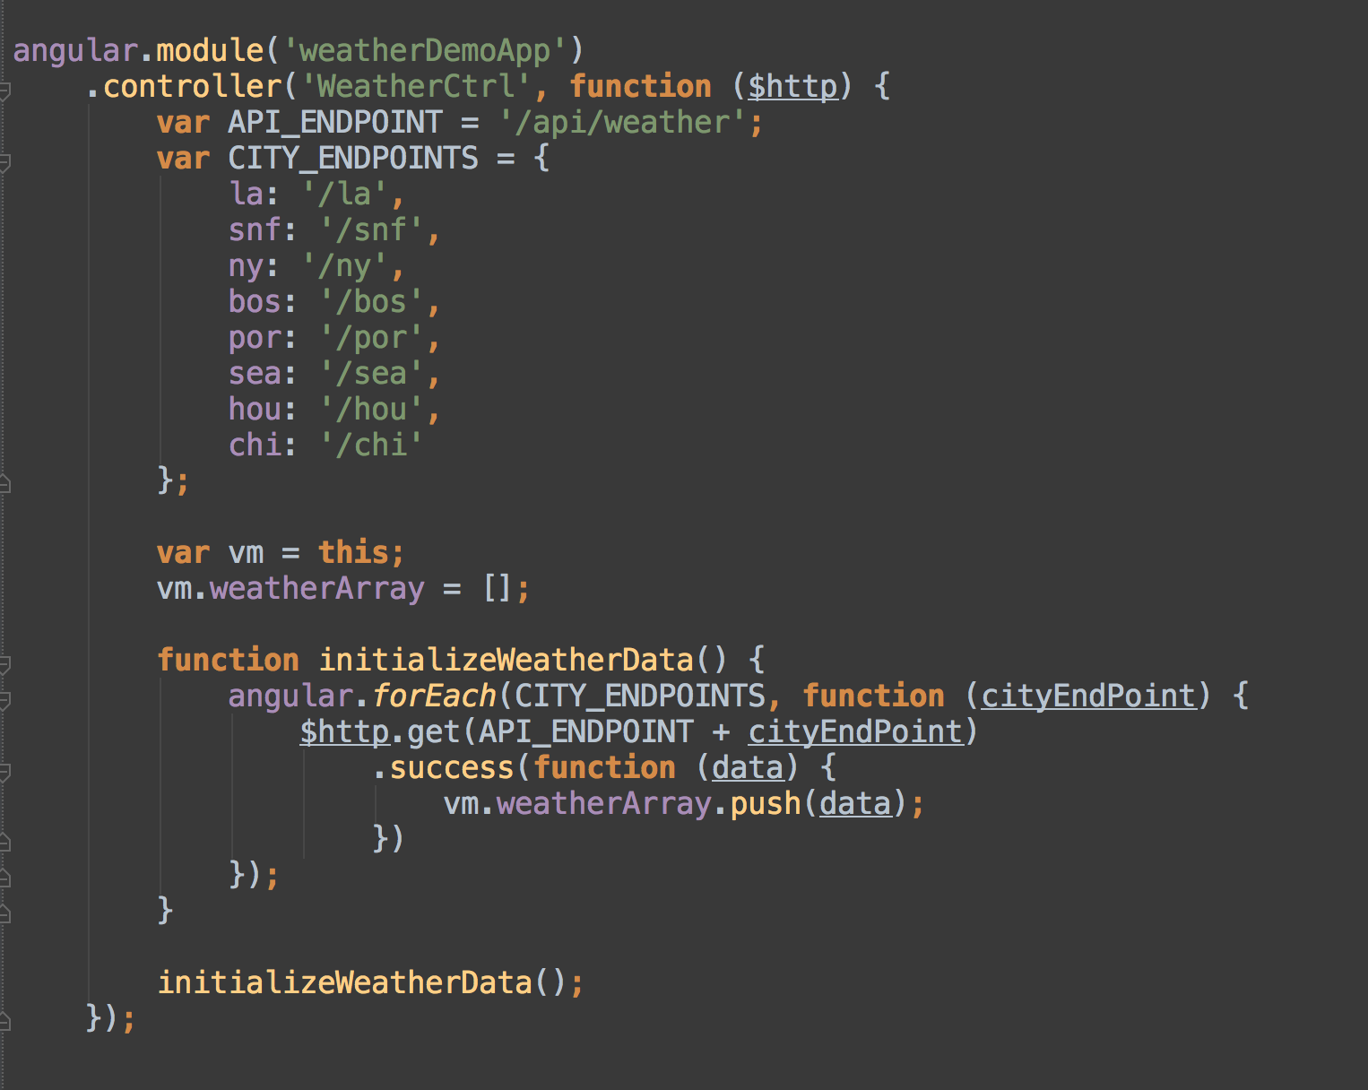
Notes:
Here’s Fred’s controller (quick walkthrough)
Injects $http, calls all his endpoints in an initialize function
When the data comes back he pushes it onto the DOM
Fred’s even using the controller as syntax instead of using scope – way to go fred!

Slide 7
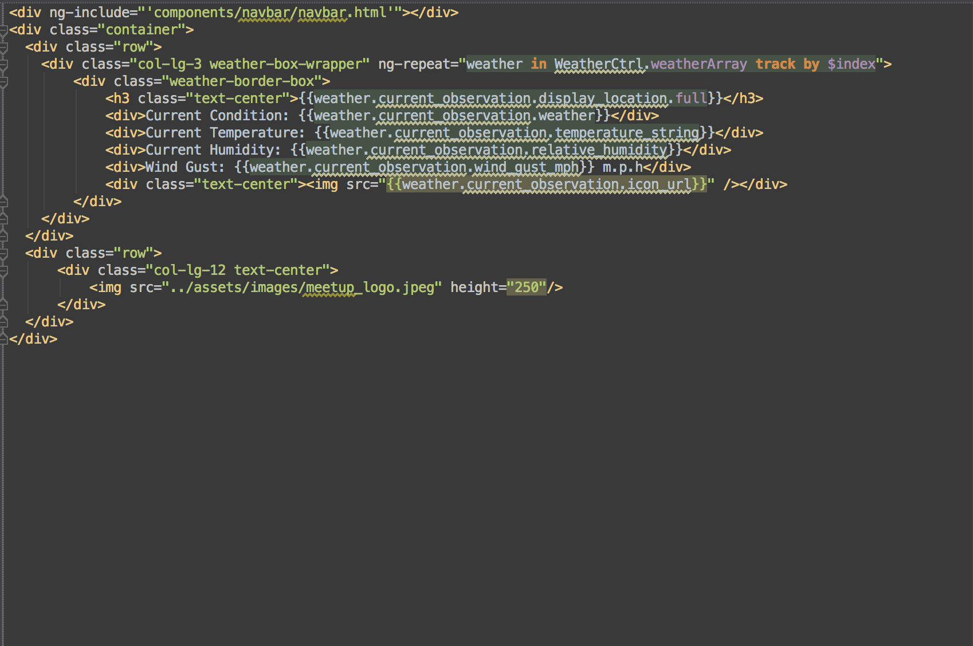
Notes:
Here’s Fred’s original HTML template
Uses ng-repeat to repeat out his weather boxes
Uses part of the JSON returned from the server to render his data

Slide 8
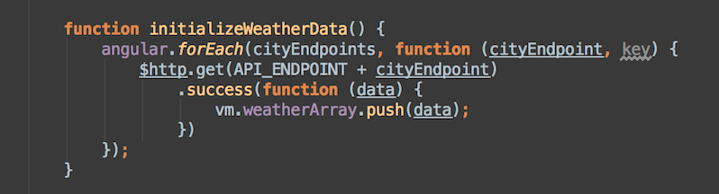
A Couple Problems
Controller has logic that doesn’t belong ($http, promise-processing logic, hard to maintain)
How are the different $http responses processed?
Notes:
If we look a little closer
Fred’s faced with a couple of problems that we try desperately to avoid with any angular app:
Has logic in the controller that the controller doesn’t need to know about – Controller knows about the endpoint, Controller invokes $http, processes the data this will not scale well if more complex processing logic is needed
EVEN IF $HTTP IS WRAPPED IN A SERVICE, How are we going to process the different errors? The controller will still have to perform all of the processing logic/error handling/notifying
Fred needs someway to abstract away all of $http so he can just ask for the data.
Our controllers should ask for data, and receive, and not have to worry about processing every possible outcome because this becomes messy and it doesn’t scale.

Slide 9
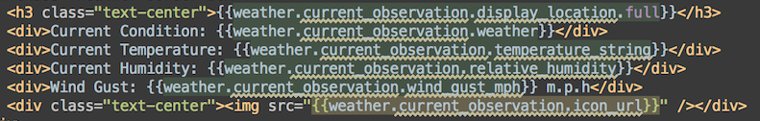
A Couple Problems
JSON format from API not that intuitive
Notes:
Fred’s API is not that intuitive. It probably made sense to the people who built it
(Thank you underground weather.com -> You made a great API….)
However, if you look at the bindings – weather.current_observation-temperature_string
Is somewhat intutive but it just looks ugly. If there was a way to simply the json to weather.condition
Weather.temperature its much more declarative.

Slide 10
It also looks awkward
Notes:
Finally this just looks awkward
Fred has a common problem, how do you get asynchronous data into the controller and then
Onto the view
Fred has an endpoint array, we have an initialization function with $http that is called once
The controller has been loaded – In an ideal world, we would like our controller to feature
Variables and functions that are directly bound to the DOM – any other needs should be
Handed over to a service. In this case, we need a better way process this Promise-based code!

Slide 11

Let’s Help Fred!
Notes:
- Let’s give Fred a helping hand. Let’s take a look at the $q service and figure out how it can help us solve the problems that were just presented.

Slide 12
$q - Angular’s promise helper
Promises are all over the place in Angular: $http, $resource, $timeout
According to the docs:
“A service that helps you run functions asynchronously, and use their return values (or exceptions) when they are done processing”
Notes:
Promises are all over the place in angular: $http, $resource, $timeout
- $q is here to assist in creating promises programmatically and to help manage asynchronous functions

Slide 13
What can $q do for you?
Using the deferred/promise API helps makes asynchronous processing easier
Using the deferred/promise API can also help us manage and wrap promise-based functions.
$q.defer()
resolve, reject, defer.promise
Notes:
$q allows us to wrap asynchronous or long running code in a promise so that processing these functions becomes easier to manage
$q also gives us the ability to wrap a promise other services create, which allows us to keep the processing of these functions in one place
To create a defer object invoke $q.defer. when invoking this function, you get an object that has a resolve and reject feature and a promise that can be used when this deferred object is resolved or rejected at some point in the future.
We now have complete control of what happens when our asynchronous code is done executing if we wrap it in our own deferred object. Instead of having to process asynchronous code like $http throughout our app, we can wrap it in one place, do all the processing logic in one place, and abstract the behind-the-scenes work from every other part of our app
Let’s apply this to Fred’s app and we will see what the result is!

Slide 14
Wrap $http in a service and utilize $q

Slide 15
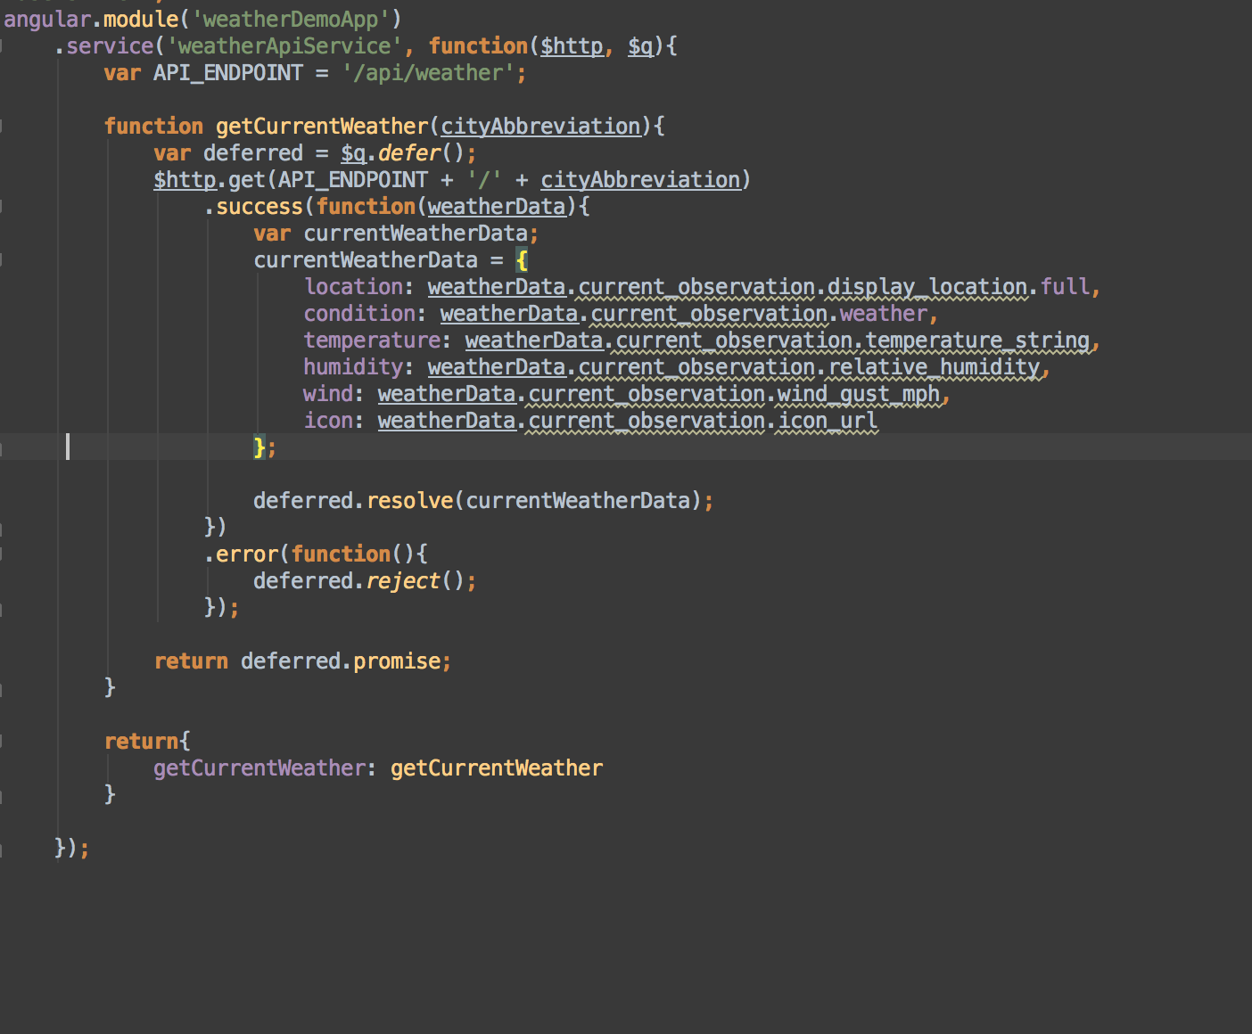
Notes:
*Walk through – no discuss*
Now fred creates a new service to wrap his $http call. He’s going to wrap that in a
Promise using $q.defer to create a new defer object
Then when the $http call comes back, Fred is going to process his data and make
The json a little more readable.
Now that it’s packaged nicely, let’s resolve our promise. In the return statement, you will
Notice, that we return the deferred.promise object, which can be used with a then block
As you normally would using the promise API.

Slide 16
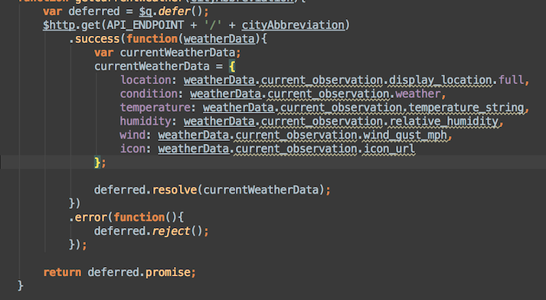
What did this give us?
Abstracted away $http
Put all success/error logic in one place
Simplified the JSON
Notes:
Abstracted away $http – We have now successfully taken away our http dependency so our controller is none the wiser. If we want to use cached data at some point, or our data comes from somewhere else, our controller is none the wiser – this is much more maintainable code
We now have a place for all of our success and error logic. Fred’s app is not that complex, but let’s imagine that he needed to do things based on different errors that came back or notify different parts of the app of these errors we can now consolidate all this in one place and not have to worry about doing it in the controller. We have now made a re-usable service that gives us back predictable results
Also we can use our deferred object to simplify the JSON – Remember this format?

Slide 17
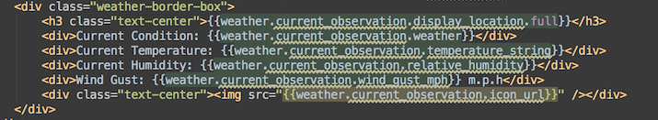
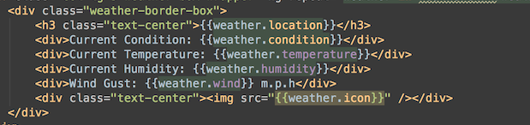
Notes:
Now we even have some nicer looking HTML and the controller is none the wiser!

Slide 18
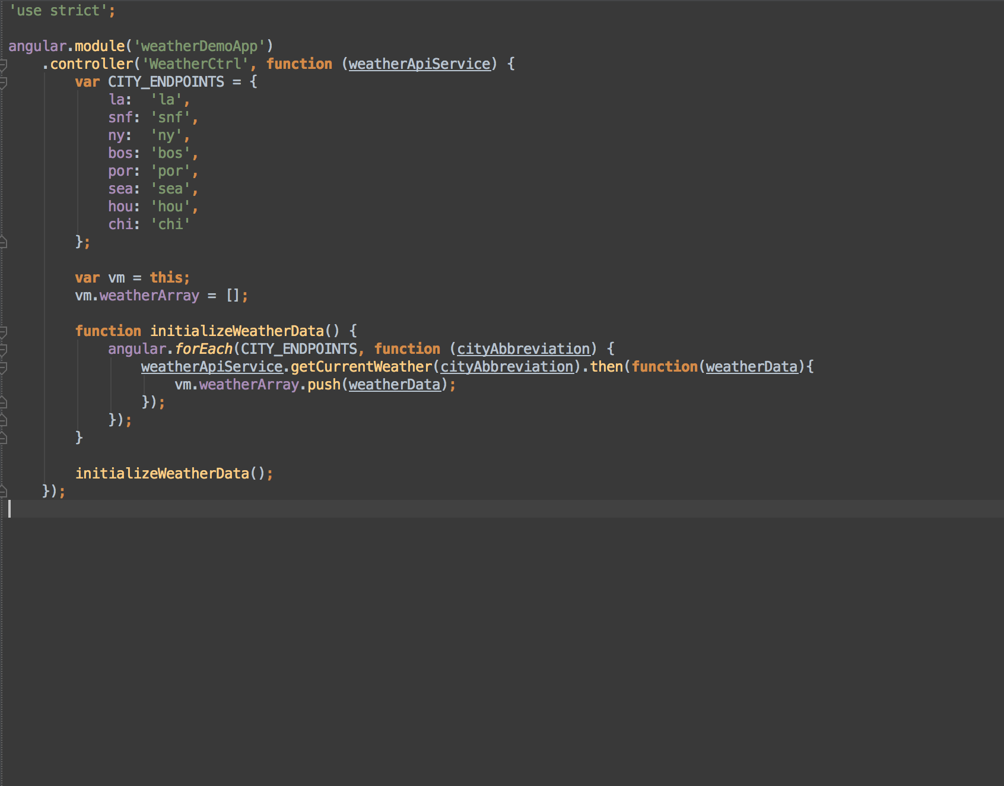
Notes:
Also, our controller is looking slightly better. We have gotten rid of $http
Now we have Control of the promise but we still have this initializer function.
- Let’s look at route resolve and see how that can help process these now wrapped in $q promises

Slide 19
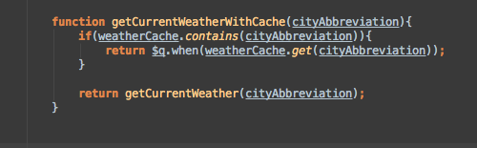
Not covered in this app, but worth noting
$q.when – wraps an object into a $q promise
Could be used for something like caching if a caller expects a promise
Notes:
- Aside -
As I talk about the deferred object, another feature worth noting
That won’t be in the sample app is $q.when. This wraps an object
In a $q promise and can be used in something like caching or
Wrapping a function that you are not sure returns a promise or not
Here is what our weatherApiService looks like with caching built in

Slide 20

Let’s take it one step further
Notes:
Initializing data for a controller and a view is really common in an
Angular app
Fred’s predicament is much like ones we run into all the time: how do we initialize data for a controller in a way that is scalable where we can separate concerns from different pieces of our app
Wouldn’t it be nice if the data was just there?
Let’s use the route resolve to help us further separate our promise-based Code from our controller initialization

Slide 21
Route Resolve
Provided in Angular’s $routeProvider
Also available in other routers (like U.I. router in this project)
“An optional map of dependencies which should be injected into the controller. If any of these dependencies are promise, the router will wait for them to resolve… If all promises are resolved successfully, the value of the resolved promises are injected”
One catch – all must resolve for the route to load
Notes:
Route resolve is part of setting up routes in $routeProvider or in other routers of your choice (U.I. router being the one
For this project).
Allows you to inject additional dependencies in your controller. If any of them are promises, the controller
Won’t load until the data is ready! We could greatly simplify our controller code!
One Catch – all of them must resolve in order for the route to load. However, in our case, since we have our code wrapped in $q, we can make sure everything resolves successfully even on error so our route will load. This may not always be the scenario for your app but for ours, it works great.
Let’s do a little more refactoring to take advantage of this route resolve feature

Slide 22
Using $q and route resolve…

Slide 23
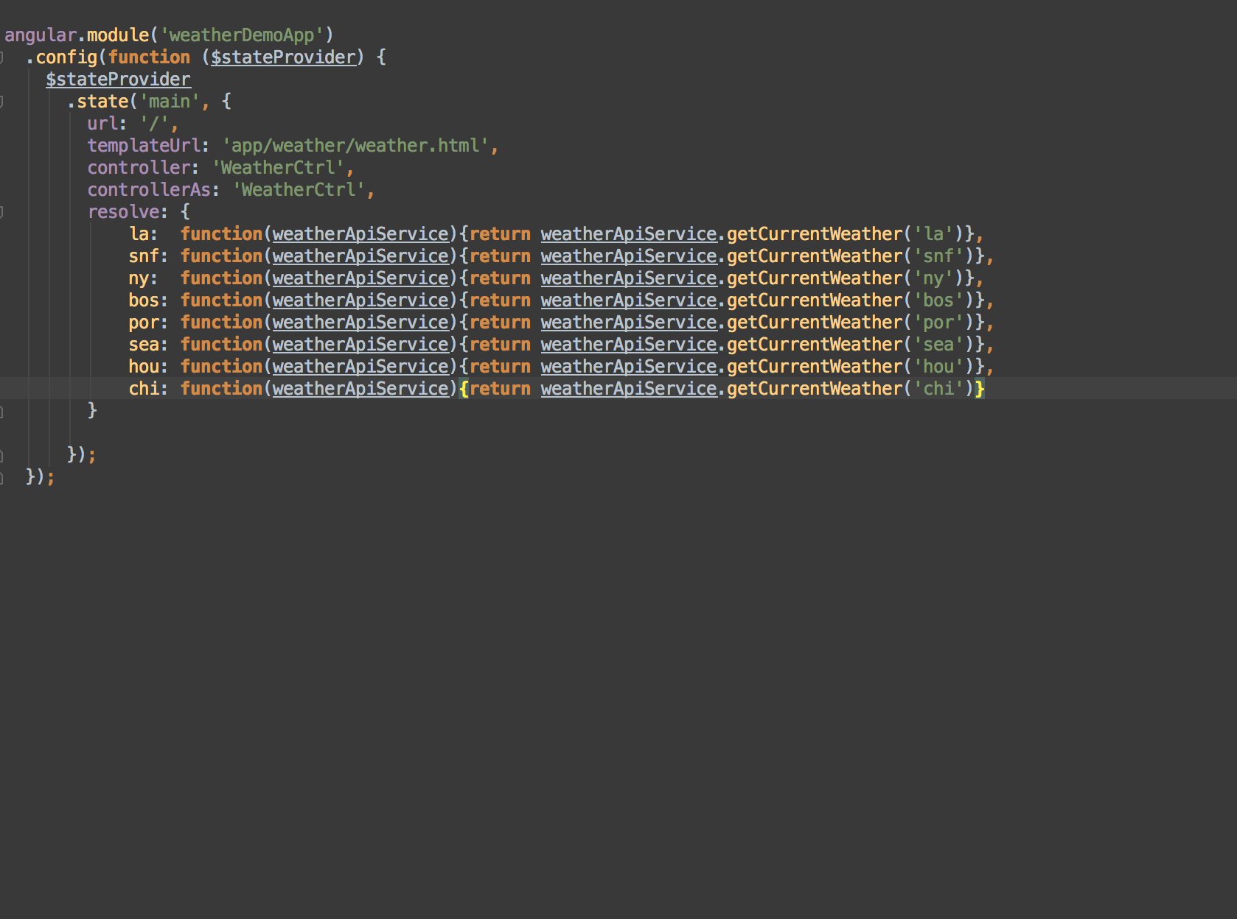
Notes:
Let’s take our calls to the weatherApiService out of the controller and have it load when the route loads
Here we see the configuration block our app and now we have moved that initialization function out of the controller completely.

Slide 24
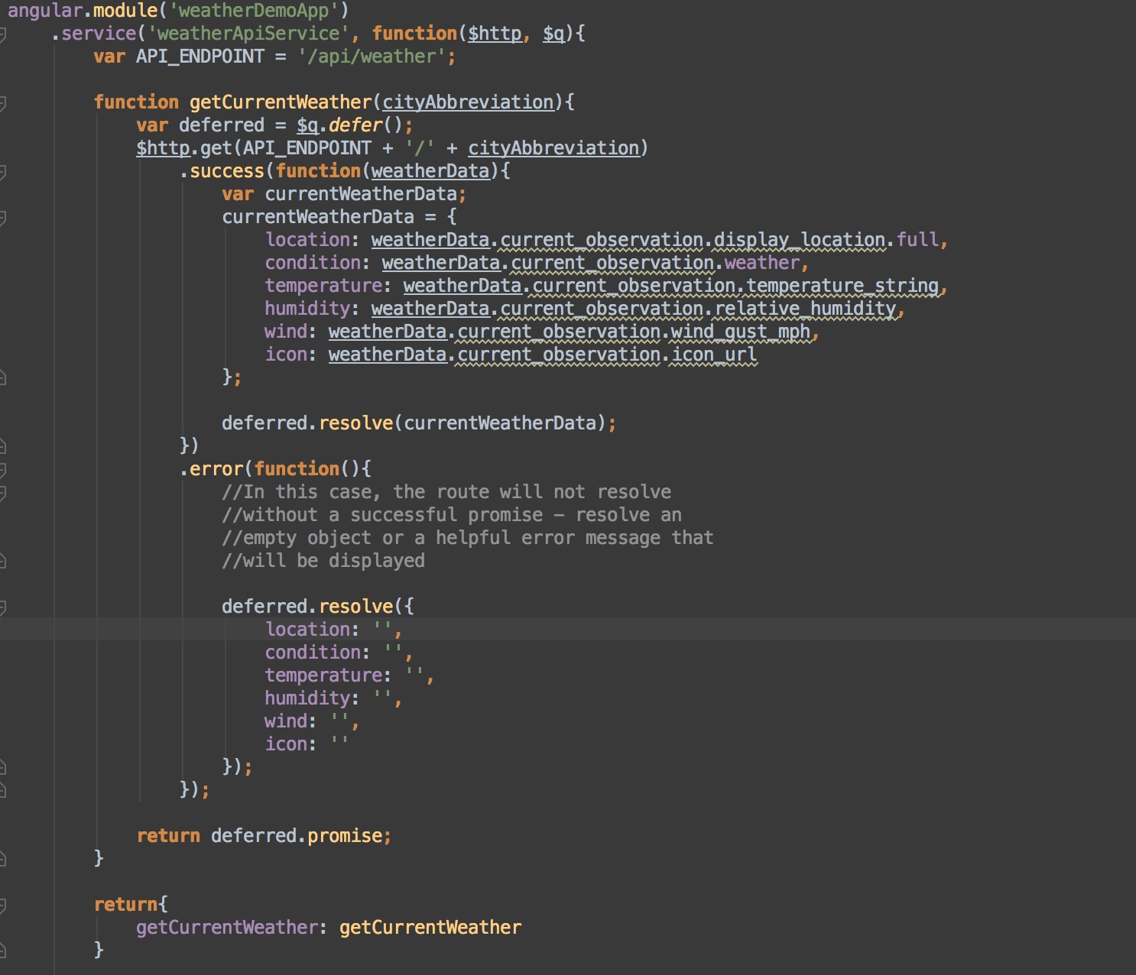
Notes:
Here’s our service now – notice how even on error, we can still return
A resolved promise because we have utilized $q and its’ services.
You may not want to always resolve a promise that wraps a rejected promise
But in our case, we can guarantee that our route will resolve correctly and we can ship this data right to the DOM.
If we ever wanted to change when and how we resolved this promise, because we are using our deferred object and we are returning route resolve our own promise, we can easily change implementations.

Slide 25
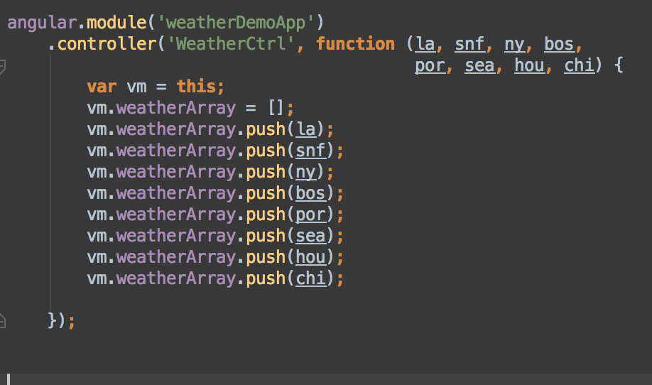
Notes:
Look at this controller – heck yeah!
We’ve dispatched of all the initialization code and now all the controller
Has to do is render a view!
However, I think we can take it one step further - $q has one more feature
That will help make our code even better.

Slide 26
$q.all
Another nifty feature of the $q service
“Combines multiple promises into a single promise that is resolved when all the promises are resolved.”
We can wrap all of our initial data in one promise
One Catch: All must resolve or the promise is rejected
Notes:
Here is the last step in Fred’s refactoring!
We can combine multiple promises into a single promise
That will resolve if all of them resolve.
Now we can re-write our initialization code to be even slicker
Keep in mind – if any promise is rejected, the $q.all promise is
Rejected as well.
That’s not a problem in our case because our api service always resolves,
However, something to keep in mind

Slide 27
To finish it off…

Slide 28
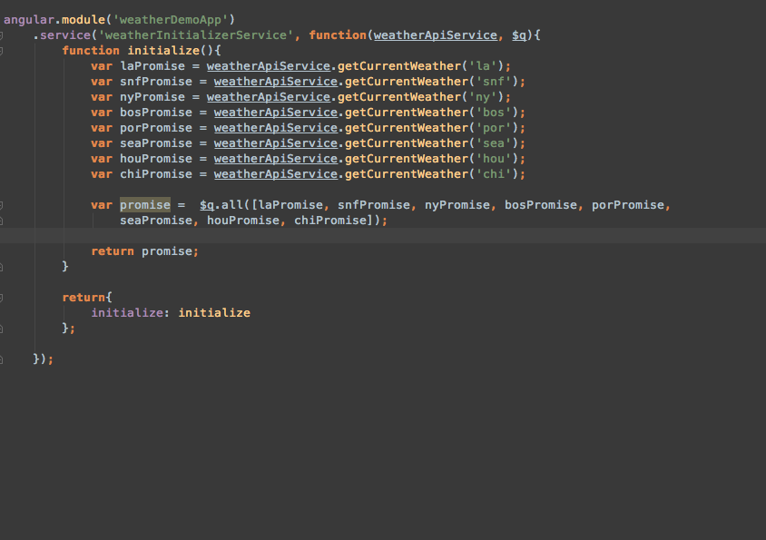
Notes:
Let’s create a new service that wraps up all of our promises and uses our new
Friend $q.all

Slide 29
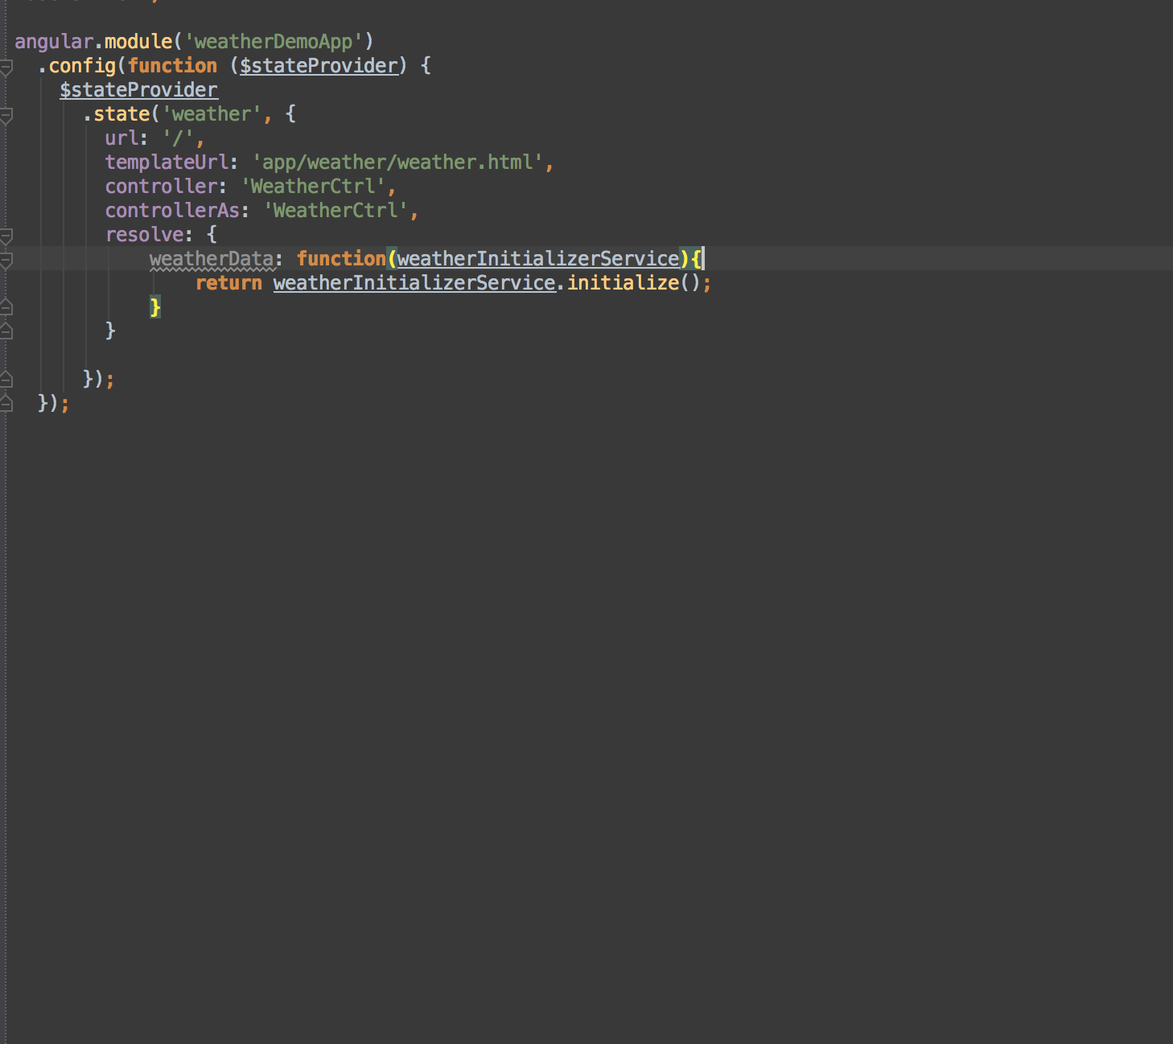
Notes:
We will modify our route using our new initializer service

Slide 30
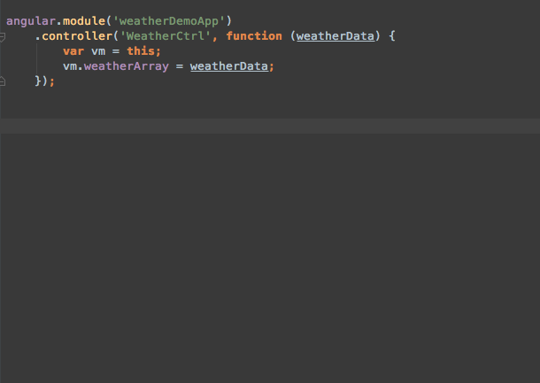
Notes:
And finally the fruits of our labor – LOOK HOW BEAUTIFUL IT IS!
No business logic, just a controller and its data bound to the template ☺

Slide 31
Notes:
By using $q, $q.all, and route resolve
We can take business/processing logic out of the controller
We get more maintainable code
We can control how and what our promises resolve to
We can get guarantees about our promises since we are the ones managing them
If you don’t already, use $q and the asynchronous world is wide open to you!

Slide 32


Thank you!

